Slide 1
(Workshop Presentation) MinCast: A New Strategy To Improve Blockchain Broadcast Network
Akshat Shetty, Adhrit Shetty
Jiaxiang Zhu, Jin Hyung Park Presentation Videos: https://drive.google.com/open?id=1YDNW1N9TrNdd0VqYhDPAkqHmC8xXVTPY

Slide 2
Motivation:
Blockchain as a technology has gained prominence over the world
Broadcast Network is utilized to transmit blocks as part of a distributed consensus protocol
However, vanilla broadcast’s unstructured nature leads to a lot of duplicate messages being introduced in the network, resulting in high messaging overhead
And simply limit the broadcast ranges would result in an increase of propagation delay to the performance

Slide 3
What Is Our Goal (Initially in Proposal):
Propose a new optimized block broadcasting propagation strategy that could minimize the broadcast overlap/overheads and improve propagation efficiency, within the context of blockchain networks
Adopt the design principles of Kadcast, a propagation strategy that makes use of Kademlia, and improve upon it for better security and performances (!)
Perform both simulated and real-time (!) testing and compare the results with those of other existing strategies to determine the strengths of our strategy and the degree of improvements
(!): This is a bit change in direction compares to our initial proposal, due to time limits and other aspects
More explanation in next slides and in our video presentation

Slide 4
Plan Changes:
We initially decide to come up with our own strategy from scratch. However, after evaluating many previous works, this would not work as intended due to time/resource limits.
We decided to build our strategy on top of KadCast (BNS), which is a recent development that utilizes buckets to cluster peers.
We would evaluate our strategy/approach against Vanilla Flooding broadcast and KadCast to check the improvements.
We will only use Network Simulator (NS3) to showcase our results. Although we have mentioned the real-life scenarios, it is much more work than we initially anticipated to get it ported on actual servers.
We have ignored the possibilities of Byzantine nodes due to time constraints and the increasing complexity of it.

Slide 5
What Are We Planning In The Strategy?
The Information Message System: Instead of sending out the actual blocks to all the peers, we only send out the information of this block to a portion of the peers, so that they can retrieve the block at a later time. The percentage is based on an InformRatio parameter to distribute the block vs. information.
The Score System: Use point-to-point latency between the node and its peer to calculate a score for the connection, which is then used to decide the payload of the sender: block or information.
Other Supporting Functions: We have also included updates and tweaks to the existing message queue to handle the information and the later retrieval of the block based on it.

Slide 6
Ideas That We Want to Implement Later?
Use Regions of the Server for Intra/Inter Clustering of Nodes: The idea is to cluster nodes based on network latency, and then assign a routing node for each cluster. These routing nodes are used to carry out inter and intra cluster broadcast.
The Byzantine Nodes: The idea is to increase the network tolerance to Byzantine nodes. KadCast has security measures that we also want to improve later.

Slide 7
Previous Works:
KadCast: A bucket-based broadcast strategy based on Kademlia that helps clustering peers in a more efficient way so that overhead of are significantly reduced.
Evaluation of Kademlia: The paper compares bucket-based and prefix-based broadcast strategies in Kademlia. It also proposes additional measures to tackle node churn and measures the effect of these strategies on node coverage, message to node ratio and imbalance factor. Not specific to the blockchain use case but helps understand the logic behind decisions made in KadCast
Blockchain-based multi-level scoring system: The paper proposes a luster multi-level reputation system with parameters, where the trust is based on a relation between a node and a system. Even though it is not directly related to our approach, it helps initializing the idea of using a score system for blockchain broadcast.

Slide 8
Vanilla Broadcast:
Issued transactions are broadcasted in network of coin nodes, then, validator nodes, which are elected by fault tolerant mechanism, collect these transmitted nodes and verify the transaction, ordering transition into blocks.
Blocks are broadcasted to all existing nodes in the blockchain network, requiring an efficient and consistent broadcast operation
In BNS, broadcast only happens in the second step above, and will send the block to all of the peers in iteration

Slide 9
KadCast Broadcast:
Overlay Construction with Buckets:
Kadcast utilizes Kademlia’ s overlay structure to enable more efficient broadcast through the use of buckets
Block Propagation:
Since Kademlia’ is UDP-based protocol, Kadcast’s data transmissions are short-lived and cost efficient allowing more scalable and dynamic propagation
Reliable Block Delivery:
Kadcast minimizes packet loss in network by making use of multiple delegates and by parallelizing the algorithm

Slide 10
MinCast Broadcast:
InformRatio (Redundancy/Minimal Broadcast):
In order to avoid overheads, transmit only a portion of the peers with actual block and the rest with information or knowledge, sending small messages
Later Retrieval/Eventual Consistency: Only retrieve the actual block when needed, and use the information to retrieve the block from nodes that have it
Score System:
Score connections based on the point-to-point latency and determine priorities using those score

Slide 11
Potential Issues with MinCast Approaches:
MinCast might fail to provide better results when competing with proven strategies such as Kadcast. At the very least, MinCast should definitely offer improvements over the vanilla broadcast approach
MinCast score system would help with the propagation, but it is limited due to the nature of NS-3. It is possible that the latency value is not as consistent as NS-3 offers, which may cause larger overhead during the latency benchmark. It is also not consistent and would have issues if there are stale blocks
Since the time is limited, we would not consider utilizing the factors such as throughput and Byzantine nodes. These are bigger factors in real-life scenarios that might invalidate our results in a way or another

Slide 12
System Layouts:
Ubuntu Linux, Python/Shell Scripts
8 CPUs and 8~12 GB RAM
BNS (Blockchain Network Simulator) as base
Majority of the implementation are in C++ through the use of NS-3 Library
Using Python/Shell Scripts combines with Matplotlib to plot graphs
Compare across these scenarios: - Vanilla (Unsolicited vs. Solicited) - KadCast - MinCast (InformRatio vs. Score System)

Slide 13
Test Methodology (1):
Unlimited Blocks + 60 Minutes Test: We run each scenario with unlimited blocks mined, and stop the simulation after 60 minutes.
Unlimited Blocks + 180 Minutes Test: We run each scenario with unlimited blocks mined, and stop the simulation after 180 minutes.
1 Block + 1000 Minutes Test: We run each scenario with exactly 1 block mined, and stop the simulation after 1000 minutes. This should give enough time for the 1 single block to be properly broadcasted to each node in the network. This is the main test that majority of our conclusions are based on.

Slide 14
Test Methodology (2):
There are some common variables to set for consistency purposes: --nMiners=16: We set the number of miners to only 16. --nPeers=500: We set the number of Peers to 500. --nMinutes=60/180/1000: We set the number of minutes to 60, 180, 1000. --nBlocks=0/1: We set the number of blocks to be mined to 0, 1. --kadBeta=3/5: We set the number of parallel broadcasts to 3 or 5. (We will add more details about this later) --net=vanilla/kadcast/mincast: We set the strategy to vanilla, kadcast, mincast.
All the other variables are using default values set in BNS, and we will mention specific ones that only work in specific scenarios.

Slide 15
Unlimited Blocks + 60 Minutes Test (kadBeta=3):
We initially try to use this test to justify our optimization strategy. However, we have found that due to the randomness in mining, the miner would mine different amount of blocks within same time range.
As you can see in the data, all the runs have different amount of blocks being mined (from as low as 2 to as high as 9 blocks within 60 minutes), which would impact the results such as the overall coverage rate and the block propagation time.
Also, considering 60 minutes certain blocks may not have long enough to be properly broadcasted to all nodes, leading to a reduction in coverage rate.
Vanilla UnSolicited: Command …… terminated with signal SIGKILL. Runs out of memory with a single block in our test.
KadCast kadBeta=3: Median TTLB: 7685.22
Coverage: 0.917333
Total number of mined blocks: 9 top block Height: 9
Stale rate: 0 totalTraffic: 1.95708e+10 overheadRatio: 3.42817
MinCast noScore kadBeta=3: Median TTLB: 5155
Coverage: 0.912
Total number of mined blocks: 2 top block Height: 2
Stale rate: 0 totalTraffic: 2.168526e+09 overheadRatio: 1.3467
Vanilla Solicited: Median TTLB: 7310
Coverage: 0.93
Total number of mined blocks: 2 top block Height: 2
Stale rate: 0 totalTraffic: 1.49008e+09 overheadRatio: 0.596651
MinCast Score kadBeta=3: Median TTLB: 17779.1
Coverage: 0.864
Total number of mined blocks: 5 top block Height: 5
Stale rate: 0 totalTraffic: 4.46144e+09 overheadRatio: 0.830716

Slide 16
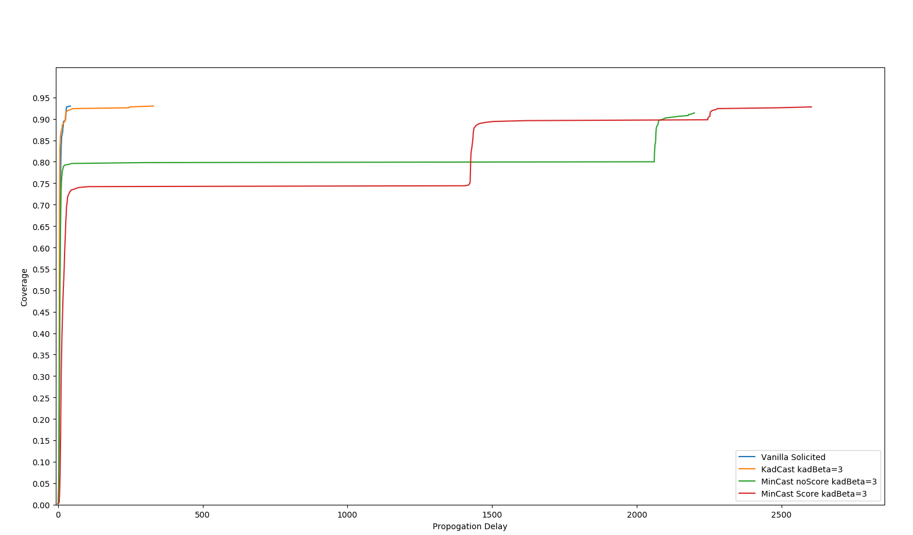
Unlimited Blocks + 60 Minutes Test (kadBeta=3):
First Block Metrics
Notes:
First Block Performance

Slide 17
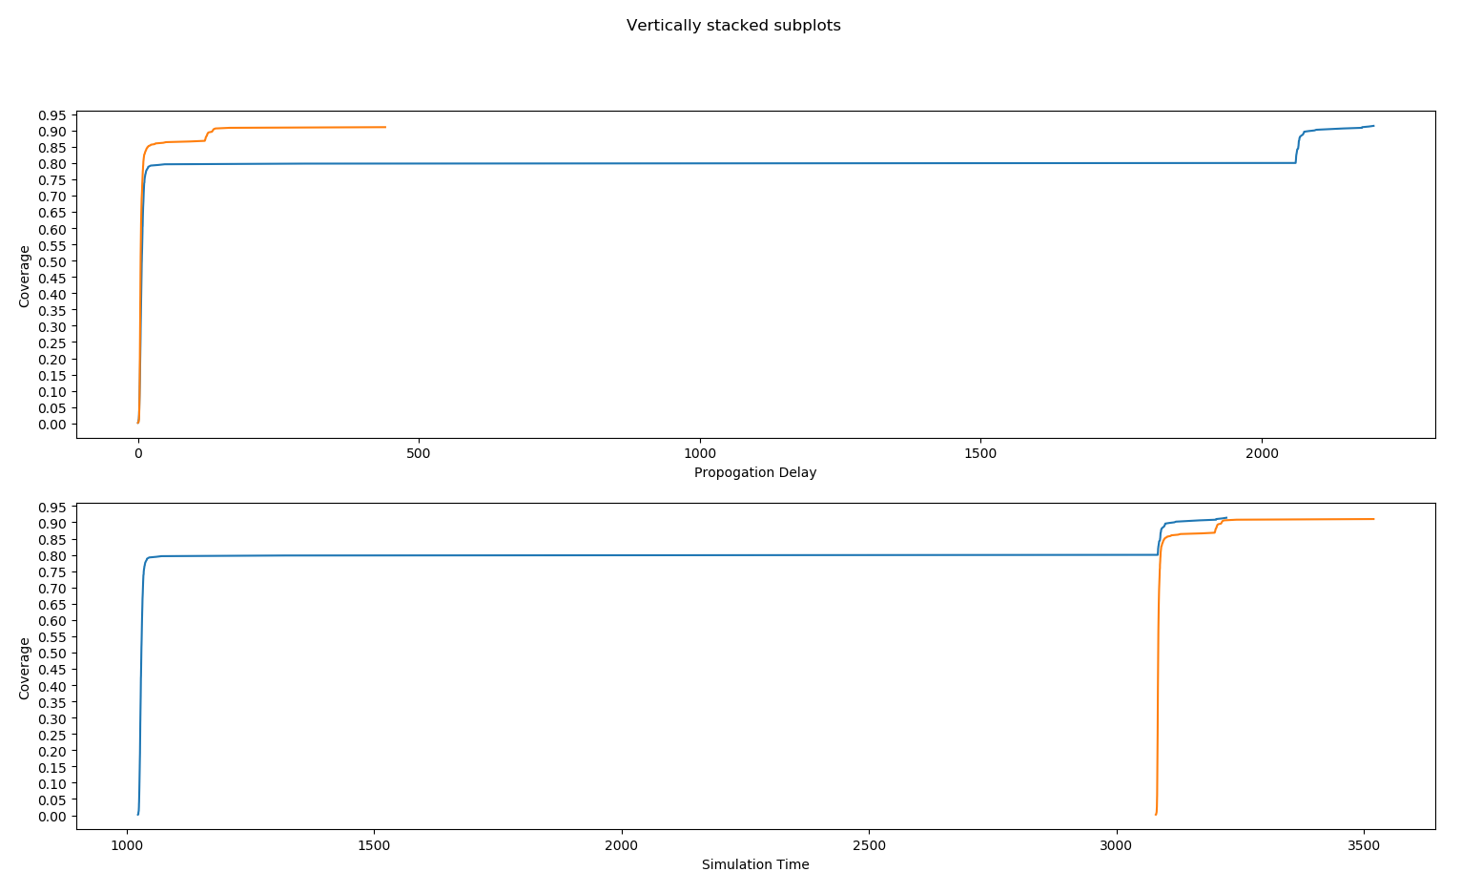
Unlimited Blocks + 60 Minutes Test (kadBeta=3):
Mincast (noScore) All Blocks Performance
Notes:
First Block Performance

Slide 18
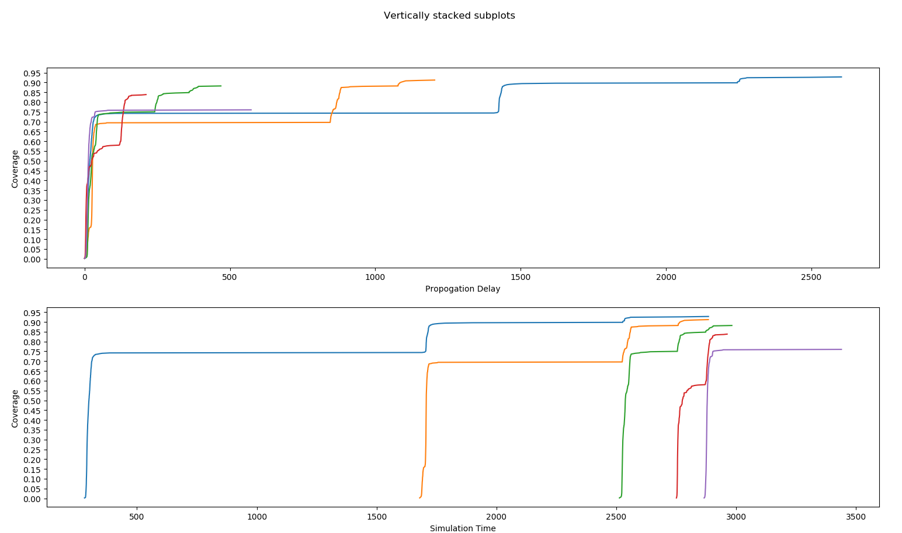
Unlimited Blocks + 60 Minutes Test (kadBeta=3):
Mincast (Score) All Blocks Performance
Notes:
First Block Performance

Slide 19
Unlimited Blocks + 60 Minutes Test (kadBeta=5):
We initially try to use this test to justify our optimization strategy. However, we have found that due to the randomness in mining, the miner would mine different amount of blocks within same time range.
As you can see in the data, all the runs have different amount of blocks being mined (from as low as 2 to as high as 9 blocks within 60 minutes), which would impact the results such as the overall coverage rate and the block propagation time.
Also, considering 60 minutes certain blocks may not have long enough to be properly broadcasted to all nodes, leading to a reduction in coverage rate.
Vanilla UnSolicited: Command …… terminated with signal SIGKILL. Runs out of memory with a single block in our test.
KadCast kadBeta=5: Median TTLB: 6647.45
Coverage: 0.8944
Total number of mined blocks: 10 top block Height: 9
Stale rate: 0.1 totalTraffic: 3.05208e+10 overheadRatio: 5.07495
MinCast noScore kadBeta=5:
Median TTLB: 4917.33
Coverage: 0.895333
Total number of mined blocks: 3 top block Height: 3
Stale rate: 0 totalTraffic: 4.24512e+09 overheadRatio: 3.25694
Vanilla Solicited: Median TTLB: 7310
Coverage: 0.93
Total number of mined blocks: 2 top block Height: 2
Stale rate: 0 totalTraffic: 1.49008e+09 overheadRatio: 0.596651
MinCast Score kadBeta=5: Median TTLB: 7108.27
Coverage: 0.814182
Total number of mined blocks: 11 top block Height: 7
Stale rate: 0.363636 totalTraffic: 1.36124e+10 overheadRatio: 1.62442

Slide 20
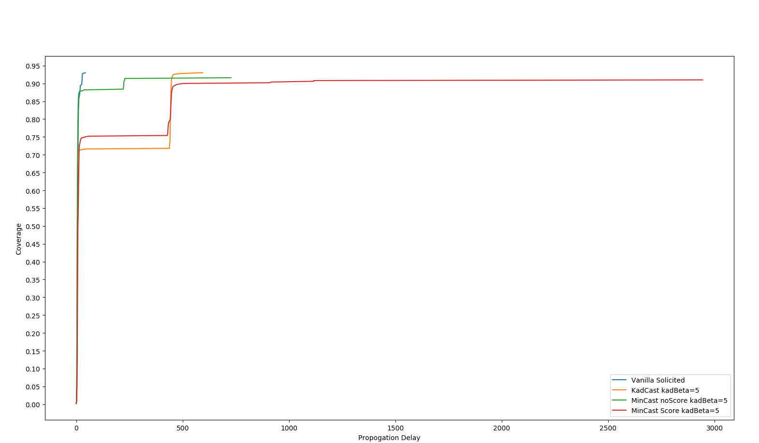
Unlimited Blocks + 60 Minutes Test (kadBeta=5):
First Block Metrics
Notes:
First Block Performance

Slide 21
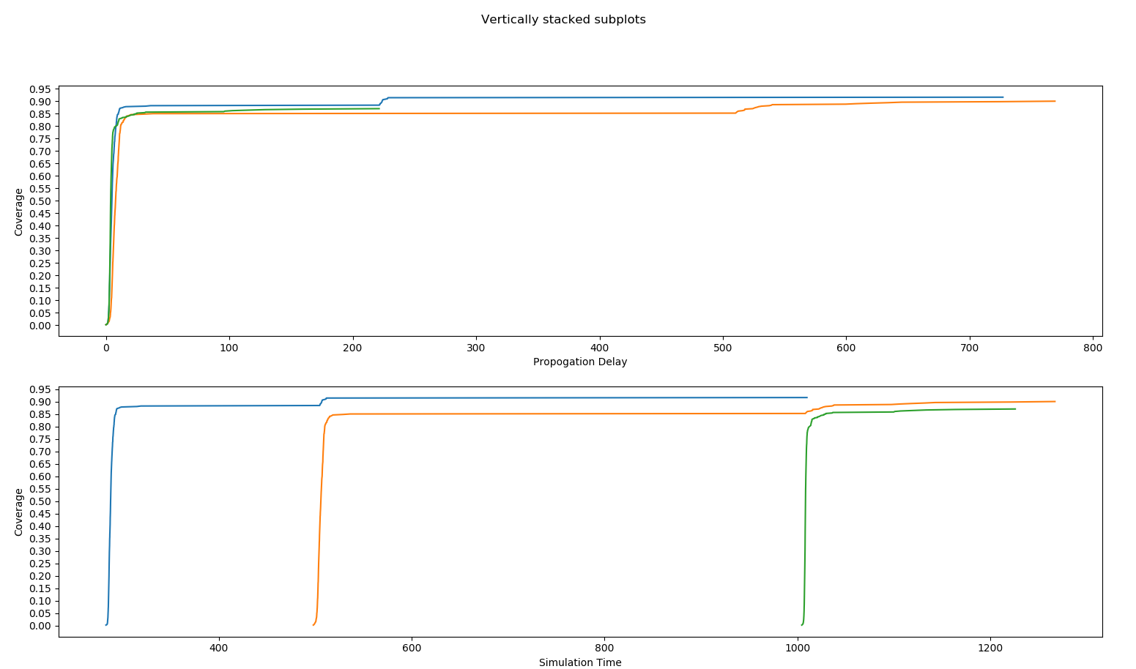
Unlimited Blocks + 60 Minutes Test (kadBeta=5):
Mincast (noScore) All Blocks Performance
Notes:
First Block Performance

Slide 22
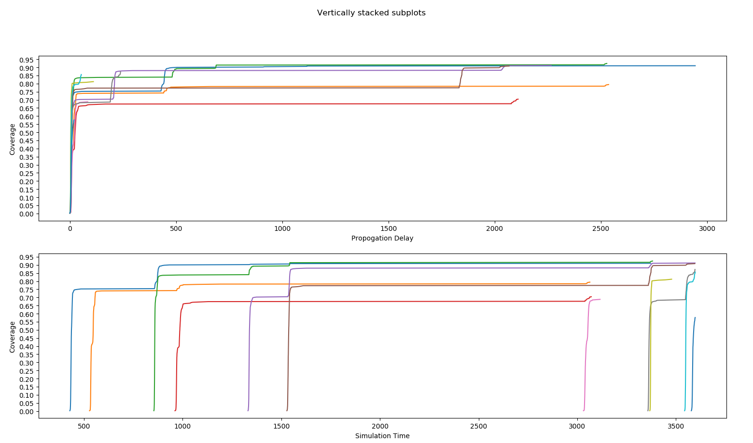
Unlimited Blocks + 60 Minutes Test (kadBeta=5):
Mincast (Score) All Blocks Performance
Notes:
First Block Performance

Slide 23
1 Block + 1000 Minutes Test (kadBeta=3):
We set the system to only mine 1 single block, and give it 1000 minutes (or any large numbers) for it to be properly broadcasted to all the nodes.
As we can see in the data, MinCast with InformRatio (noScore) manages to have 4926 seconds of propagation delay compares to 8394, 7445 and 5357 in Vanilla Unsolicited, Vanilla Solicited and KadCast, as well as very similar coverage rate compares to KadCast. The overheadRatio is also reduced to 1.55993, beats KadCast’ s 2.99202 by a mile. It is still not as good as Vanilla Solicited, but that is expected in the test.
When we change to MinCast with Score System, we have a lower coverage rate of 0.762 compares to the other scenarios. However, it has the second lowest overheadRatio (0.697167) out of all, very close to the one in Vanilla Solicited Broadcast. The propagation delay is also lower than Kadcast and the Vanilla strategies.
MinCast has truly met our expectation to be a strategy with minimal broadcast and lower overheads
Vanilla UnSolicited: Median TTLB: 8394
Coverage: 0.93
Total number of mined blocks: 1
top block Height: 1
Stale rate: 0 totalTraffic: 1.00814e+10
overheadRatio: 17.3385
KadCast kadBeta=3: Median TTLB: 5357
Coverage: 0.786
Total number of mined blocks: 1 top block Height: 1
Stale rate: 0 totalTraffic: 2.19032e+09 overheadRatio: 2.99202
MinCast noScore kadBeta=3: Median TTLB: 4926
Coverage: 0.86
Total number of mined blocks: 1 top block Height: 1
Stale rate: 0 totalTraffic: 1.40342e+09 overheadRatio: 1.55993
Vanilla Solicited: Median TTLB: 7445
Coverage: 0.93
Total number of mined blocks: 1
top block Height: 1
Stale rate: 0 totalTraffic: 5.64691e+08
overheadRatio: 0.519683
MinCast Score kadBeta=3: Median TTLB: 5501
Coverage: 0.762
Total number of mined blocks: 1 top block Height: 1
Stale rate: 0 totalTraffic: 7.93687e+08 overheadRatio: 0.697167

Slide 24
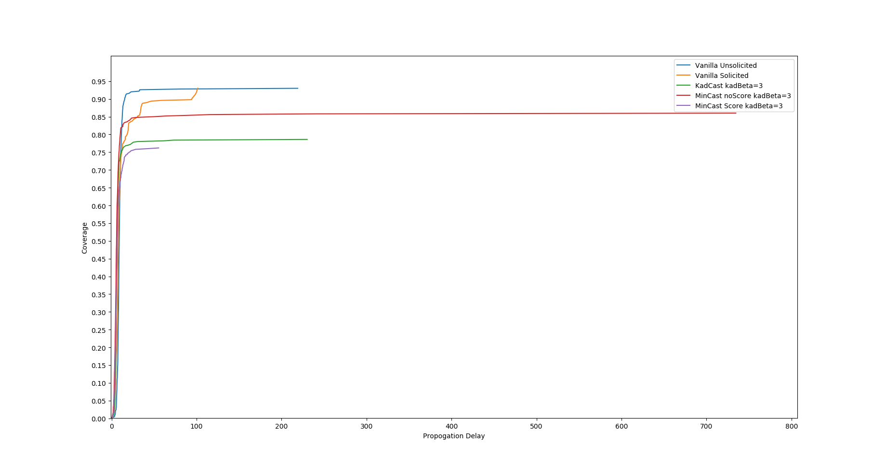
1 Block + 1000 Minutes Test (kadBeta=3):

Slide 25
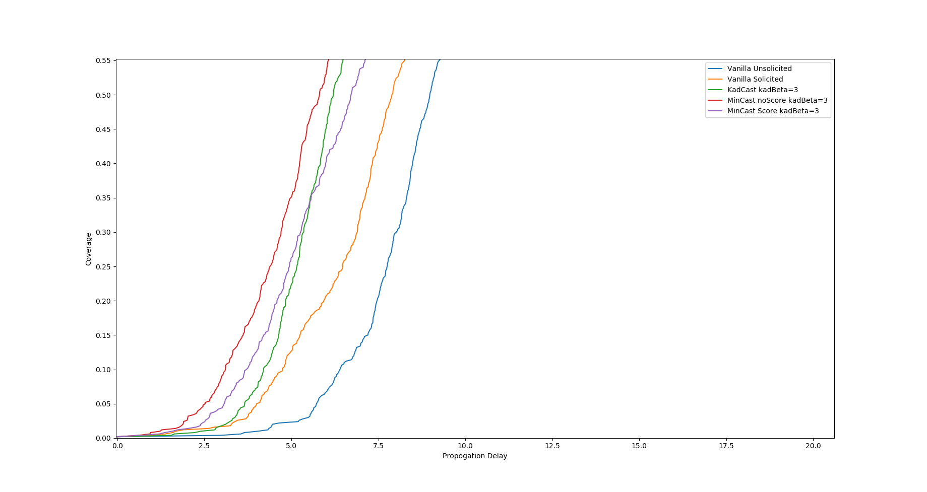
1 Block + 1000 Minutes Test (kadBeta=3):

Slide 26
1 Block + 1000 Minutes Test (kadBeta=5):
When we change the kadBeta value to 5, means we will now allow 5 parallel broadcast happening at the same time compares to the 3 we used to have.
We have even better results here in which they not only follow the trends we mentioned in the last slide when kadBeta=3, but also show improvements. Even though KadCast has very similar values in the block propagation delay (from 5357 to 5479), its coverage has a massive reduction from 0.786 to 0.678 as well as the increase in overheadRatio. On the contrary, MinCast with InformRatio (noScore) has has slightly improved coverage compares to kadBeta=3 (from 0.86 to 0.876) one, and has a slightly improved block propagation delay as well (from 4926 to 4006.5).
When checking MinCast with the Score System, we see higher coverage rate from 0.762 to 0.838, but a higher overall block propagation delay from 5501 to 7714.
Vanilla UnSolicited: Median TTLB: 8394
Coverage: 0.93
Total number of mined blocks: 1
top block Height: 1
Stale rate: 0 totalTraffic: 1.00814e+10
overheadRatio: 17.3385
KadCast kadBeta=5: Median TTLB: 5479
Coverage: 0.678
Total number of mined blocks: 1 top block Height: 1
Stale rate: 0 totalTraffic: 3.3347e+09 overheadRatio: 5.0694
MinCast noScore kadBeta=5: Median TTLB: 4006.5
Coverage: 0.876
Total number of mined blocks: 1 top block Height: 1
Stale rate: 0 totalTraffic: 1.66571e+09 overheadRatio: 3.65641
Vanilla Solicited: Median TTLB: 7445
Coverage: 0.93
Total number of mined blocks: 1
top block Height: 1
Stale rate: 0 totalTraffic: 5.64691e+08
overheadRatio: 0.519683
MinCast Score kadBeta=5: Median TTLB: 7714
Coverage: 0.838
Total number of mined blocks: 1 top block Height: 1
Stale rate: 0 totalTraffic: 1.44165e+09 overheadRatio: 1.85687

Slide 27
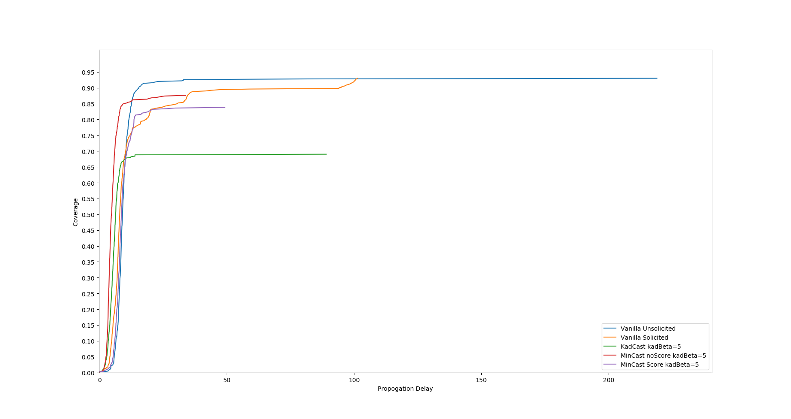
1 Block + 1000 Minutes Test (kadBeta=5):

Slide 28
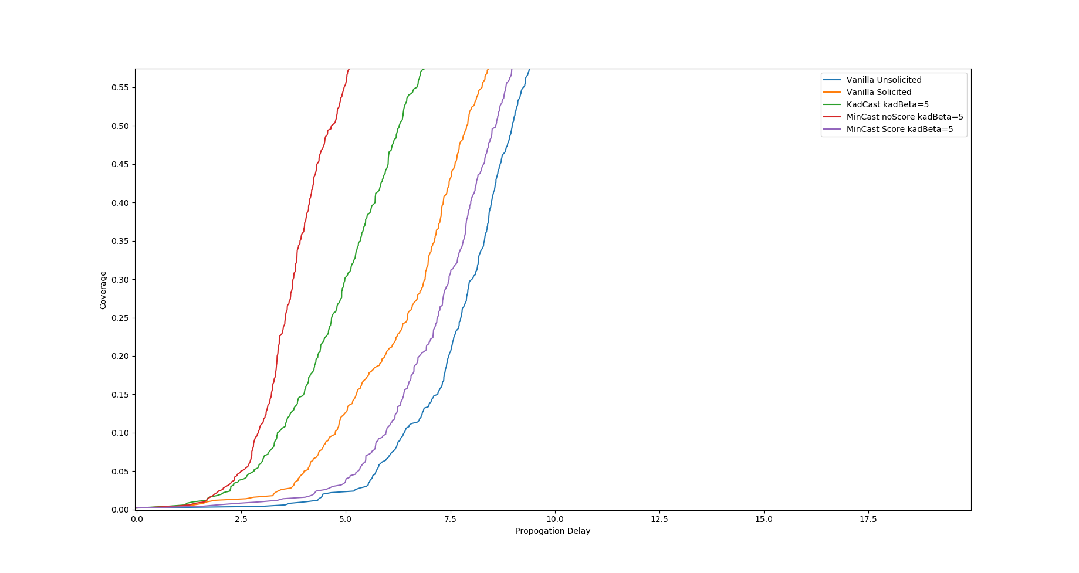
1 Block + 1000 Minutes Test (kadBeta=5):

Slide 29
Unlimited Blocks + 180 Minutes Test (kadBeta=3):
Just like the 60 minutes test, the test only changes the time range from 60 minutes to 180 minutes, in order to compare with the data presented by the KadCast paper.
We have set every parameter to be the exact same value, to ensure the maximum consistencies in the process.
The 180 minutes test is 3 times longer than the 60 minutes test, and should have better coverage results than the previous ones as the blocks that are mined in the early time frame should be properly broadcasted now.
Vanilla UnSolicited: Command …… terminated with signal SIGKILL. Runs out of memory with a single block in our test.
KadCast kadBeta=3:
Median TTLB: 4817.81
Coverage: 0.910462
Total number of mined blocks: 13
top block Height: 13
Stale rate: 0
totalTraffic: 2.65717e+10
overheadRatio: 3.20782
MinCast noScore kadBeta=3:
Median TTLB: 5777.59
Coverage: 0.888364
Total number of mined blocks: 11 top block Height: 11
Stale rate: 0 totalTraffic: 1.33599e+10 overheadRatio: 1.36188
Vanilla Solicited: Median TTLB: 15673.8
Coverage: 0.9299
Total number of mined blocks: 20
top block Height: 20
Stale rate: 0
totalTraffic: 1.54825e+10
overheadRatio: 0.549006
MinCast Score kadBeta=3: Median TTLB: 8273.3
Coverage: 0.5888
Total number of mined blocks: 10 top block Height: 8
Stale rate: 0.2 totalTraffic: 6.58284e+09 overheadRatio: 0.247529

Slide 30
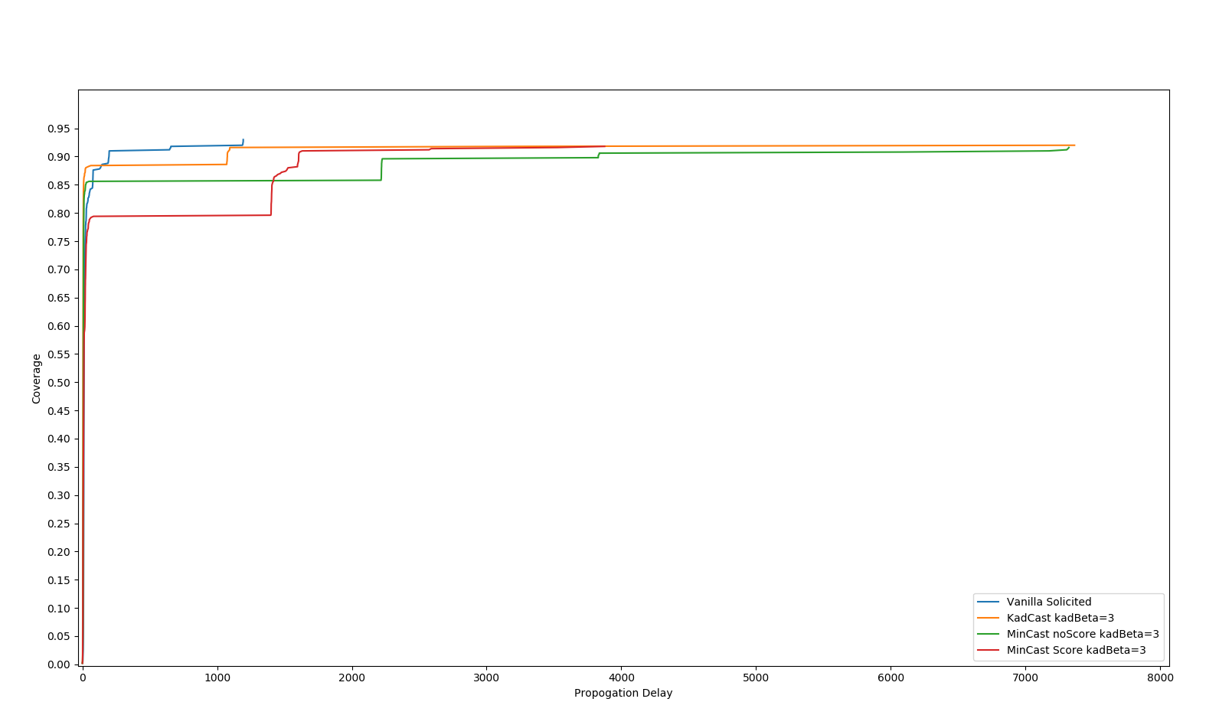
Unlimited Blocks + 180 Minutes Test (KadB=3):
First Block Metrics
Notes:
First Block Performance

Slide 31
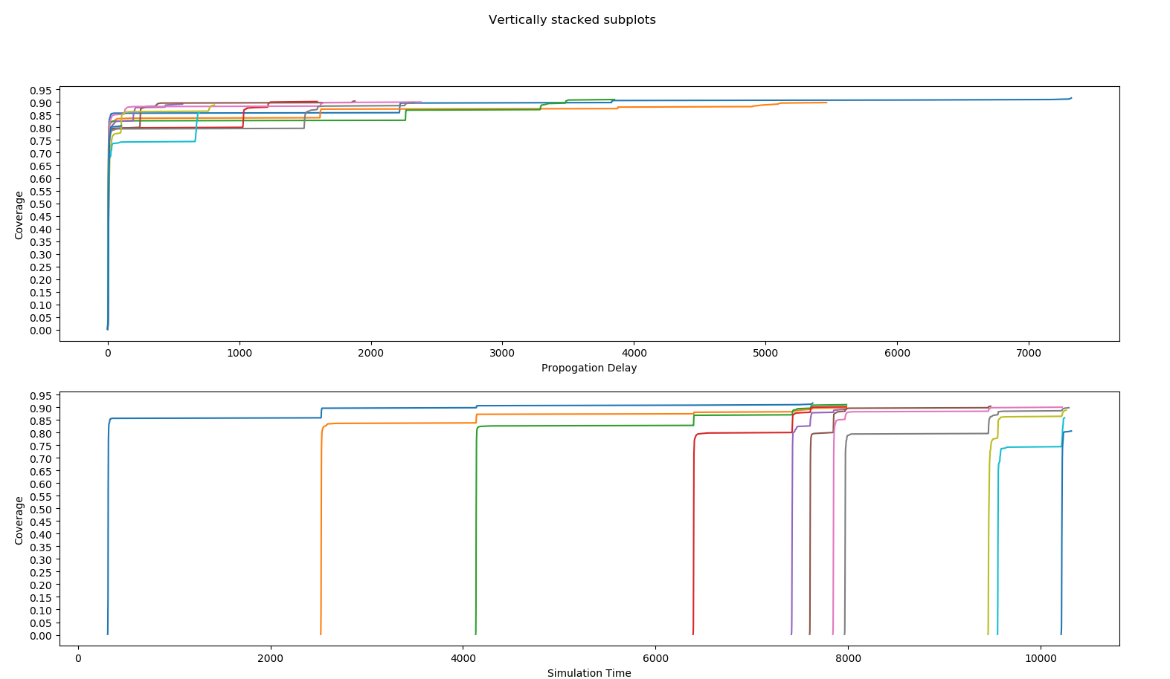
Unlimited Blocks + 180 Minutes Test (KadB=3):
Mincast (noScore) All Blocks Performance
Notes:
First Block Performance

Slide 32
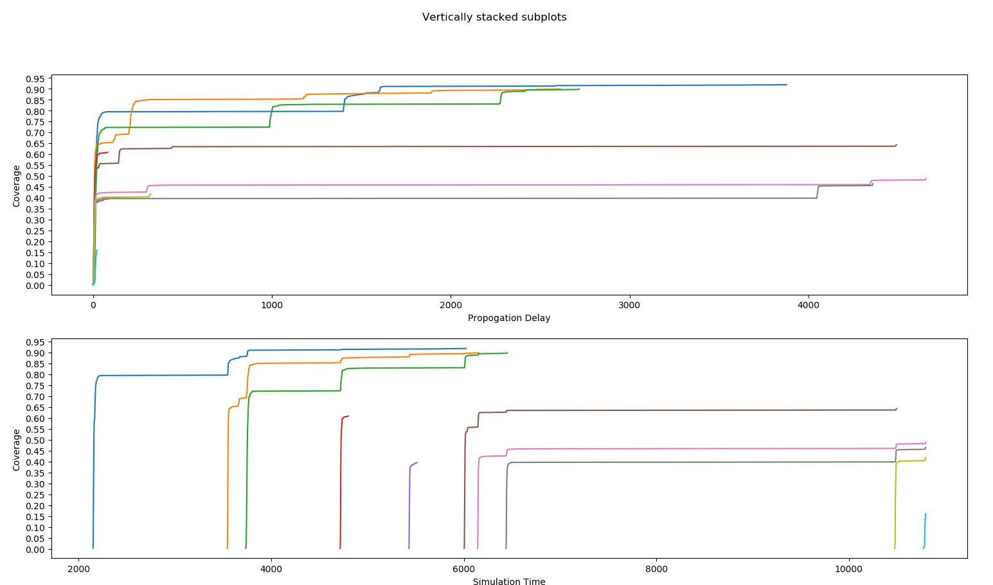
Unlimited Blocks + 180 Minutes Test (KadB=3):
Mincast (Score) All Blocks Performance
Notes:
First Block Performance

Slide 33
Unlimited Blocks + 180 Minutes Test (KadBeta=5):
Just like the previous test, the test only changes the time range from 60 minutes to 180 minutes, in order to compare with the data presented by the KadCast paper.
We have set every parameter to be the exact same value, to ensure the maximum consistencies in the process.
The 180 minutes test is 3 times longer than the 60 minutes test, and should have better coverage results than the previous ones as the blocks that are mined in the early time frame should be properly broadcasted now.
Vanilla UnSolicited: Command …… terminated with signal SIGKILL. Runs out of memory with a single block in our test.
KadCast kadBeta=5:
Median TTLB: 5378.14
Coverage: 0.901
Total number of mined blocks: 18
top block Height: 18
Stale rate: 0
totalTraffic: 6.64349e+10
overheadRatio: 6.13092
MinCast noScore kadBeta=5:
Median TTLB: 6225.82
Coverage: 0.833455
Total number of mined blocks: 11 top block Height: 7
Stale rate: 0.363 totalTraffic: 1.72138e+10 overheadRatio: 2.40352
Vanilla Solicited: Median TTLB: 15673.8
Coverage: 0.9299
Total number of mined blocks: 20
top block Height: 20
Stale rate: 0
totalTraffic: 1.54825e+10
overheadRatio: 0.549006
MinCast Score kadBeta=5: Median TTLB: 6979.29
Coverage: 0.803143
Total number of mined blocks: 14 top block Height: 11
Stale rate: 0.214286 totalTraffic: 1.87601e+10 overheadRatio: 1.73242

Slide 34
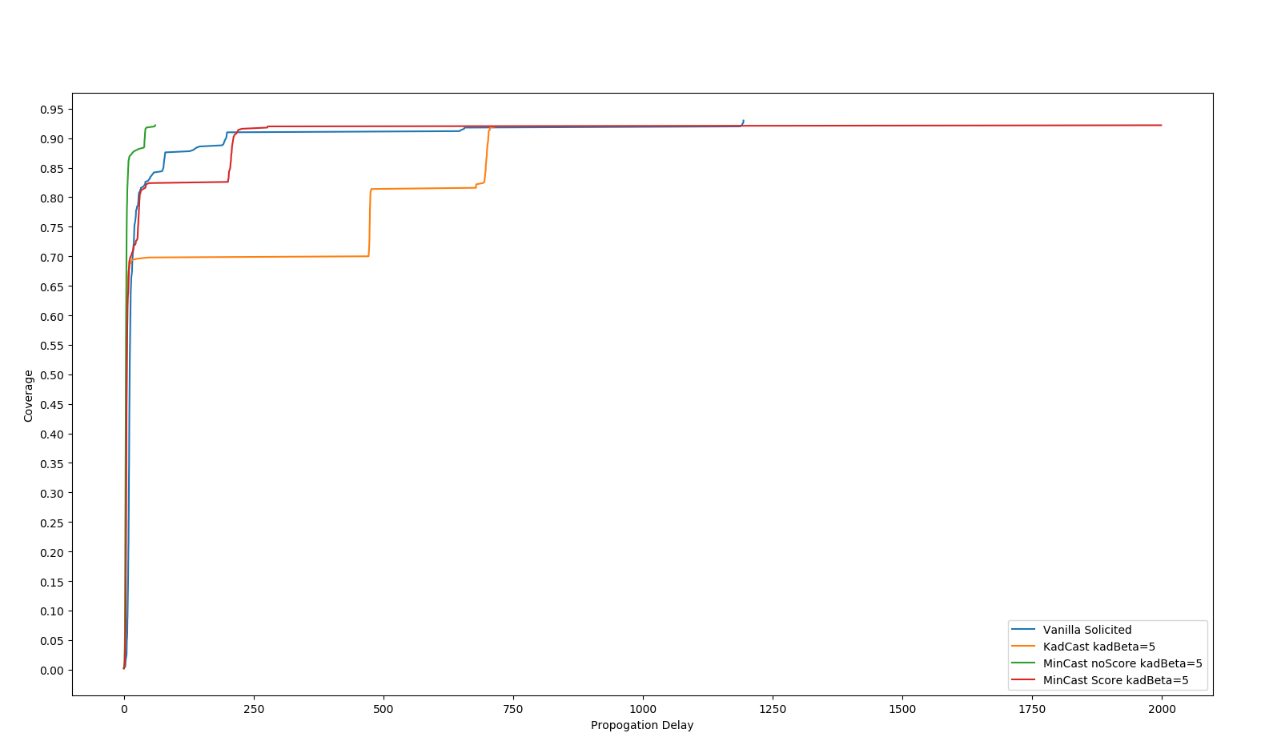
Unlimited Blocks + 180 Minutes Test (KadB=5):
First Block Metrics
Notes:
First Block Performance

Slide 35
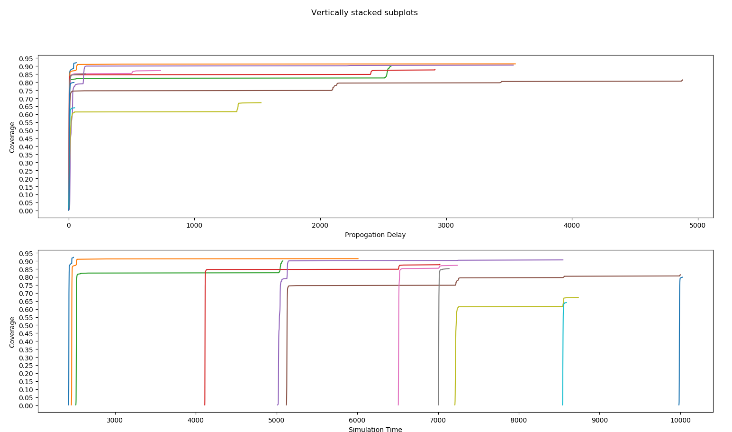
Unlimited Blocks + 180 Minutes Test (KadB=5):
Mincast (noScore) All Blocks Performance
Notes:
First Block Performance

Slide 36
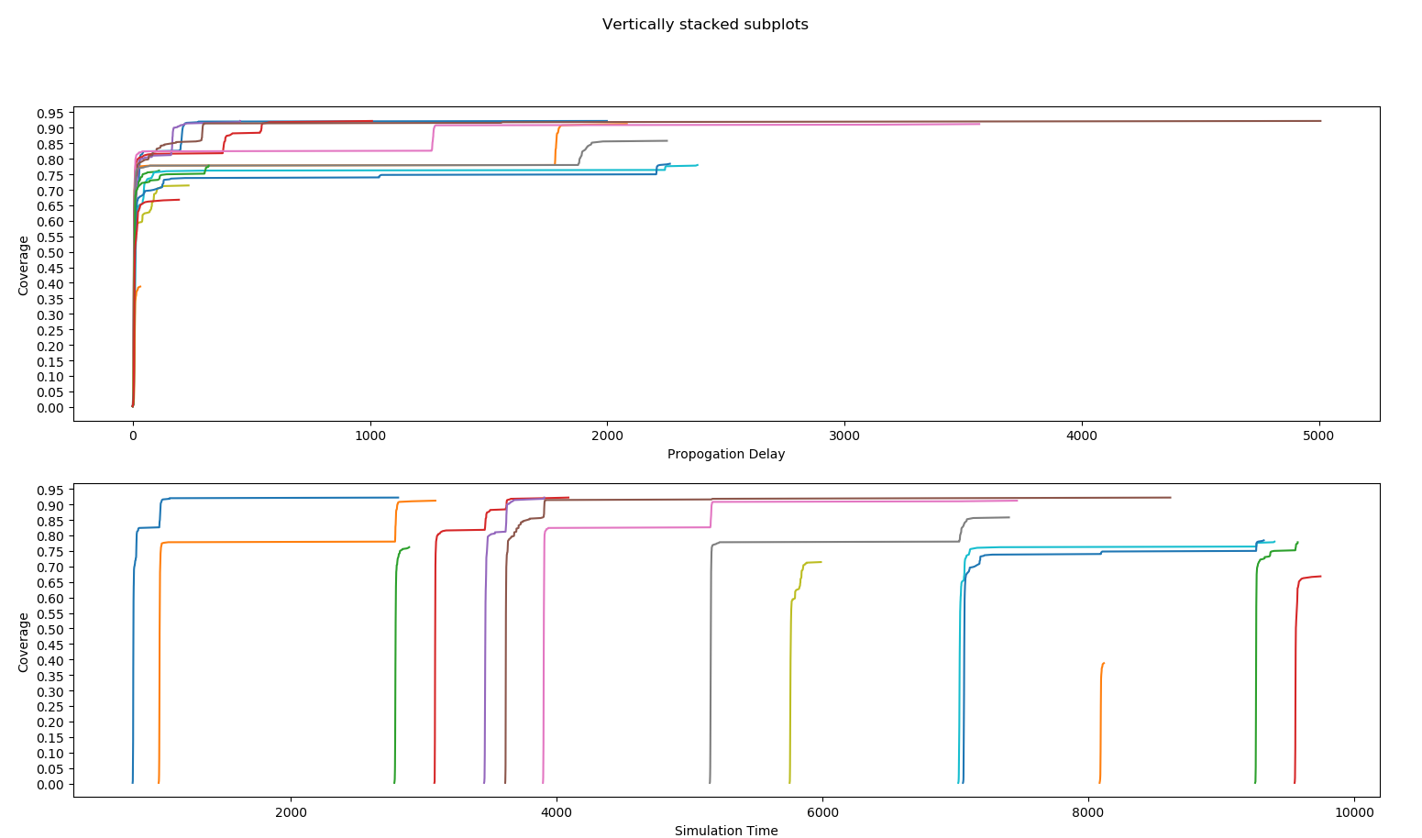
Unlimited Blocks + 180 Minutes Test (KadB=5):
Mincast (Score) All Blocks Performance
Notes:
First Block Performance

Slide 37
Special Case:
Sometimes, when testing MinCast with Score System with more than 1 Block, the coverage result is very low across multiple runs. This can be seen in the 180 minutes test with kadBeta=3.
This is an expected special case as the score system will send the blocks and the information based on the latency scores. And since the peers within the bucket can be random, it is possible that a node will have all its peers located within the same subnet, thus only send out information. With a higher parallel broadcasts value like kadBeta=5, the possibilities of sending information to all peers is reduced here.
We are re-evaluating our implementation, and are willing to give some updates with improvements in the next iteration.

Slide 38
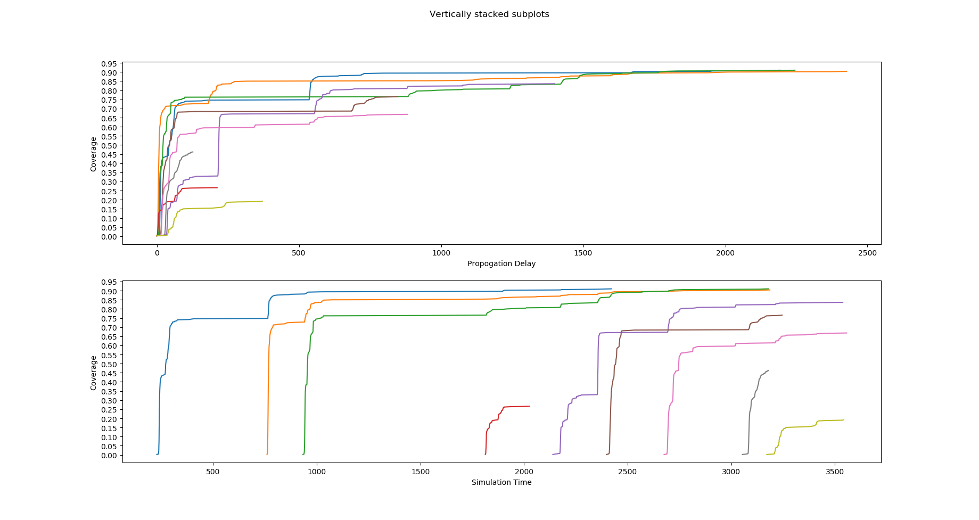
Special Case:

Slide 39
Conclusion:
MinCast is considered much better than Vanilla Unsolicited Broadcast, it is even able to compete with the Vanilla Solicited Option. The Vanilla Unsolicited Broadcast utilizes over 8GB of memory consistently (we run out of memory multiple times in the evaluation) and takes significantly longer time to broadcast a single block.
Since MinCast is built on top of the KadCast code base, it is having similar or better performance than KadCast in different scenarios. The logs we retrieve show consistent improvement of overheadRatio in the MinCast InformRatio runs compare to the KadCast runs, with lower traffic or throughput in total.
MinCast with Score System has some tradeoffs compare to InformRatio. In one way, it is better than MinCast with InformRatio in terms of overheads and throughput; in another way, it sometimes takes longer time to properly expand the coverage for each block, adds up to the propagation delays. It is also not consistent as the peers’ subnets can be random. We will try to improve it with updates in the next iteration.

Slide 40
References:
KadCast: https://dl.acm.org/doi/pdf/10.1145/3318041.3355469?download=true
NS-3 Network Simulator: https://www.nsnam.org
Bitcoin Simulator with NS3 by KadCast: https://gitlab.tubit.tu-berlin.de/rohrer/bns-public
Blockchain multi-level scoring system approach: https://drive.google.com/open?id=1RWhs-iFtYSYxhbGb9m8t0k1LYO-H38i9
Kademlia Evaluation: https://drive.google.com/file/d/1atfYVS48FZGrWJ_MBNeRW-1A5h2BuCWs/view
BlockP2P: https://drive.google.com/file/d/15_YC-8u8VjAJBhKWn19f9yEKfuRfKXtS/view
Improve Block Broadcast: https://drive.google.com/file/d/1JLDDdaNvZyvbJ_yrOfvoLD0ylC_ARmv6/view
Bitcoin-NG: https://drive.google.com/file/d/1np9aarPeWTeKd14AGt-deLlm067IW1I7/view
Adaptive Broadcast Routing Assignment Algorithm for Blockchain Synchronization Services https://drive.google.com/open?id=1YypXRU80SIyfxVeUWjbZwr0svLQxJVlc

Slide 41

Questions? … Thank you!

